Slide 1
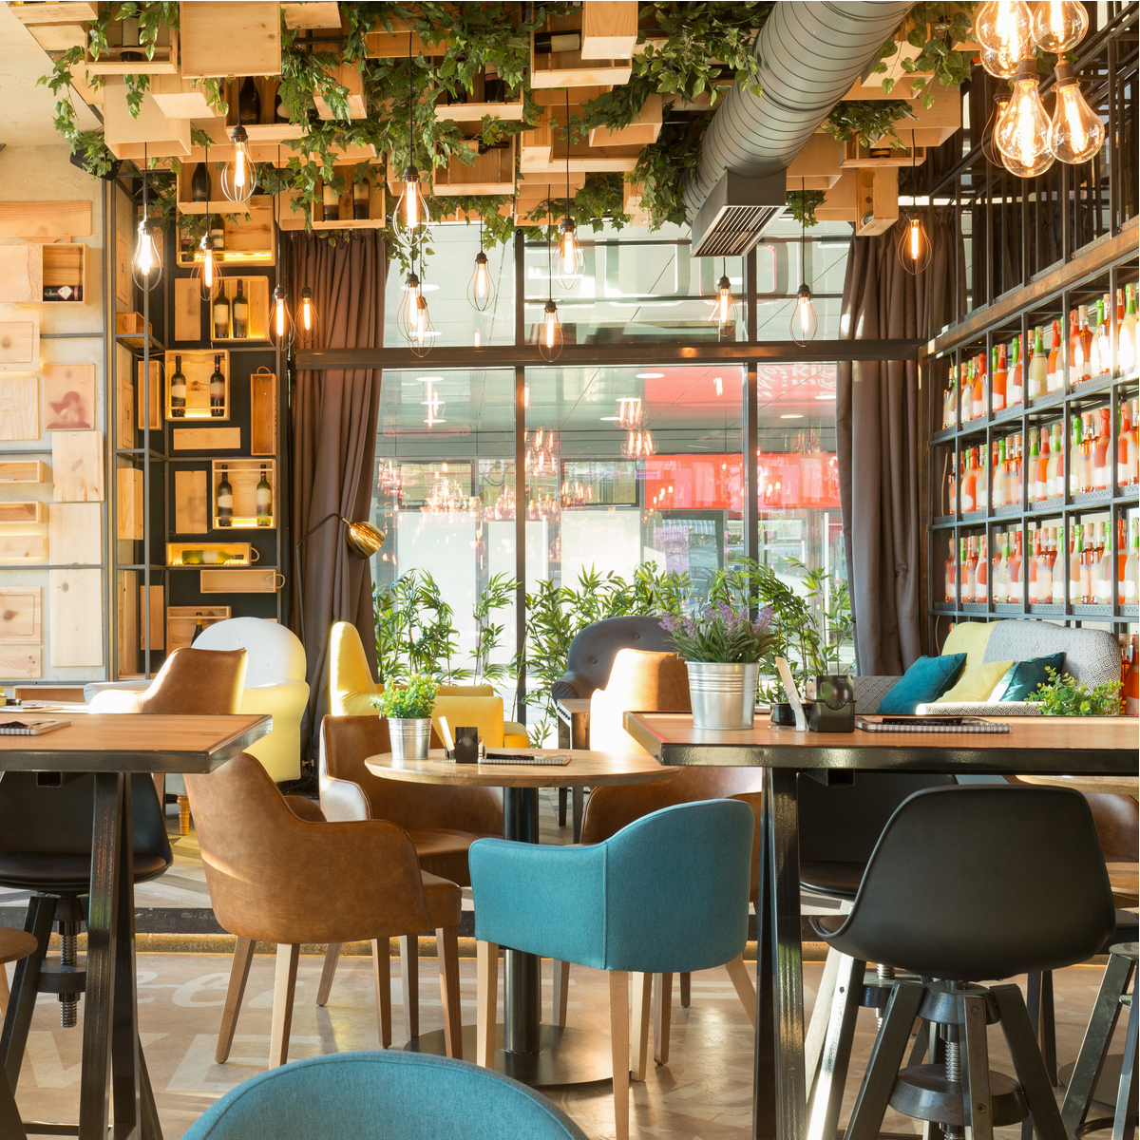
Group members are : Shweta Kaware (A-06) (TU3F1920005) Karishma Bairi (A-15) (TU3F1920014) (Group Leader) Nupoora Shinde (A-22) (TU3F1920021) Ketki Kulkarni (A-53) (TU3F1920053)
Welcome to K’s kitchen
This project is done under the guidance of Prof. Kishor Sakure

Slide 2

index
Introduction
Aim & Objective
Abstract
Literature Review
Methodology
System Requirements
Output SS
Conclusion
References

Slide 3
INTRODUCTION
Restaurant Website is built using PHP which focuses mainly on ordering food and managing food items.
Also, the system displays all the lists of available food categories.
The project is divided into two categories: Admin and Client-Side.
In an overview of this web application, the user can simply look for available food items from the client-side.
For ordering an item, the customer has to select any of the items, enter quantity with customer information. The customer information includes his/her name, number, and billing address.
On the other hand, an admin has full control over the system.
After the management of categories, now the admin can insert food items into the menu. The user can change the order status from ordered to on deliver, canceled, or delivered. This section plays the main role in the calculation of total revenue.
In addition to it, an admin can check for total revenue generated from the delivered food orders.

Slide 4
Aim and objective
This system is developed to automate day to day activity of a restaurant. Restaurant is a kind of business that serves people all over world with food. This system is developed to provide service facility to restaurant and also to the customer. This restaurant website can be used by customers to place orders without any discrepancies.

Slide 5
abstract
Restaurant website is a web-based application that has a number of features that will allow users to order foods online. This system as well as the web application’s concept is all clear, it’s the same as real-life scenarios and well-implemented on it. This Food Order Management System Project focuses mainly on ordering food and managing food items. Also, the system displays all the lists of available food categories. In addition, the system allows managing food items too. Tools like HTML, CSS, JavaScript, PHP were used to develop Food Ordering System.

Slide 6
Literature review
Year | Author Name | Paper Name | Description
2018 | Madhura M. Joshi | Automated Food Ordering System with Real - Time Customer Feedback | Since the recent revolutionary trend has been made by the smartphones usage in which the android is an operating system this platform is helpful not only for the customers but they are useful for administrators to manage their management.
2016 | Mayur D. Jakhete | Implementation of Smart Restaurant with E-Menu Card | This platform is made for the table reservation as well as the food ordering system simultaneously.
2014 | Prajakta Kulkarni | Digital Table Booking and Food Ordering System Using Android | In the past years the mobile usage and the computing has also brought a lot of change in the technology and the smartphones have been upgrading day by day alongwith making things work easy like our Food Ordering System.
2012 | Eshan Gupta | Application on Order Management Systems in Restaurant | Bringing a platform which provides food ordering was encouraged by the customers very much as well as the orders have been increasing day by day when compared to previous years.
2010 | Soon Nyean Cheong | Design and Development of Multi - Touchable E-Restaurant Management System | There has been drastic improvements in the technology where we have got the online food ordering system from remote areas as well known as online food ordering application which makes easy for user to order food.

Slide 7
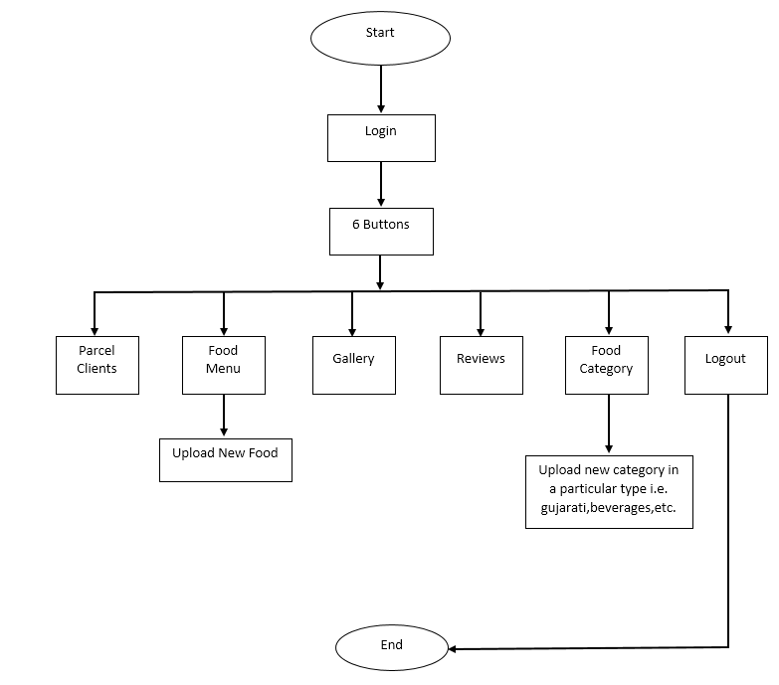
Methodology (Block diagram)
Admin side

Slide 8
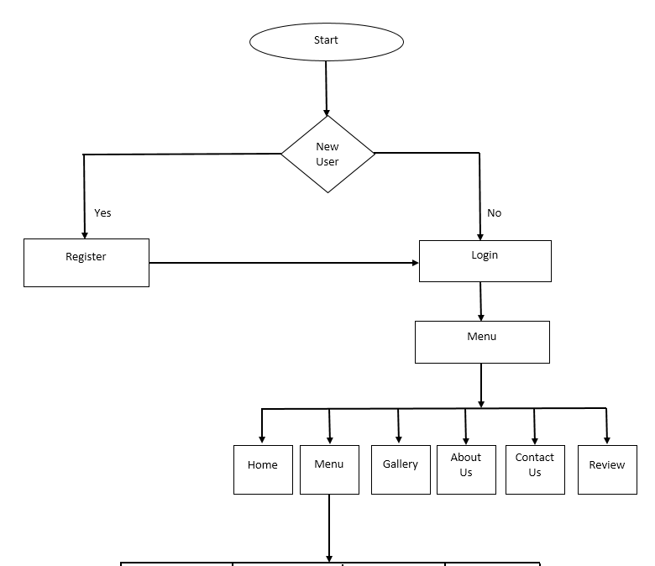
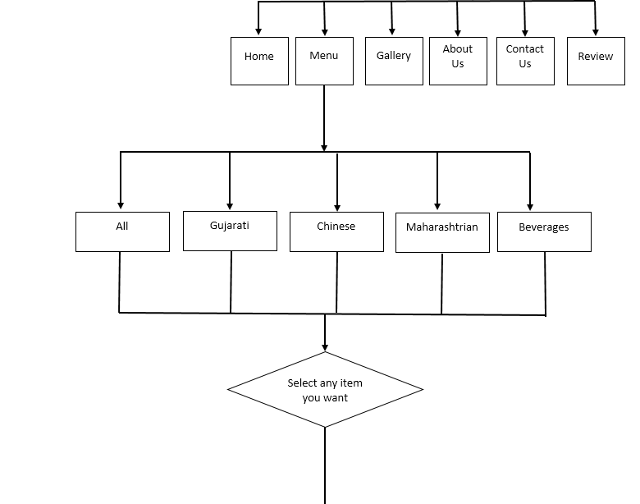
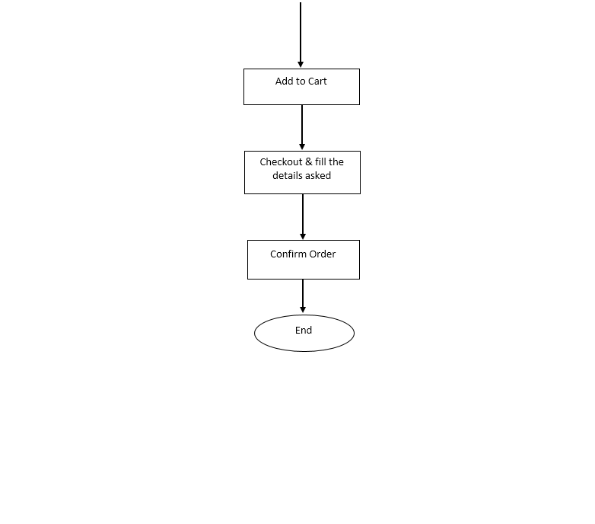
Client side

Slide 9
HARDWARE & SOFTWARE requirements
HARDWARE REQUIREMENTS:
Processor: Any PENTIUM Processor
RAM: 2 GB or Above
Hard Disk Capacity: Minimum Requirement is 80 GB
Display Type: Standard VGA or SVGA card
SOFTWARE REQUIREMENTS:
Frontend: HTML, CSS, JavaScript
Backend: PHP, SQL

Slide 10
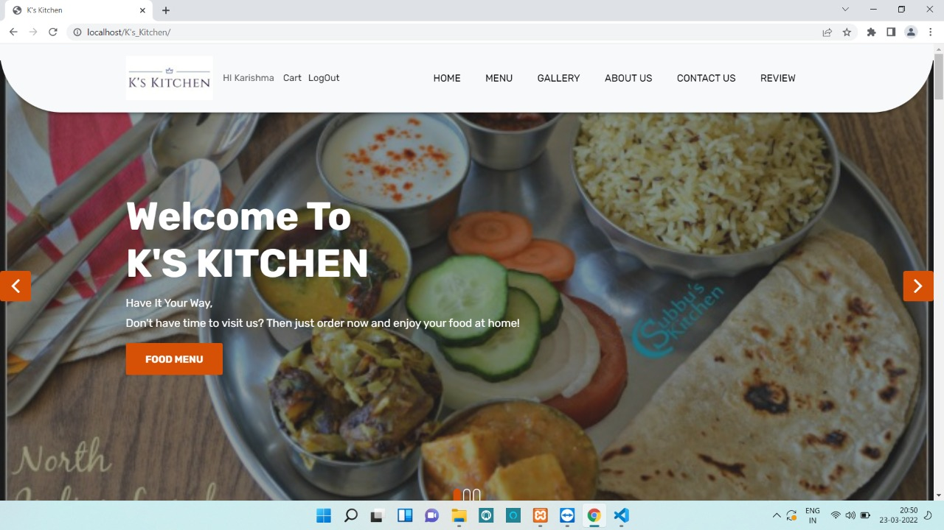
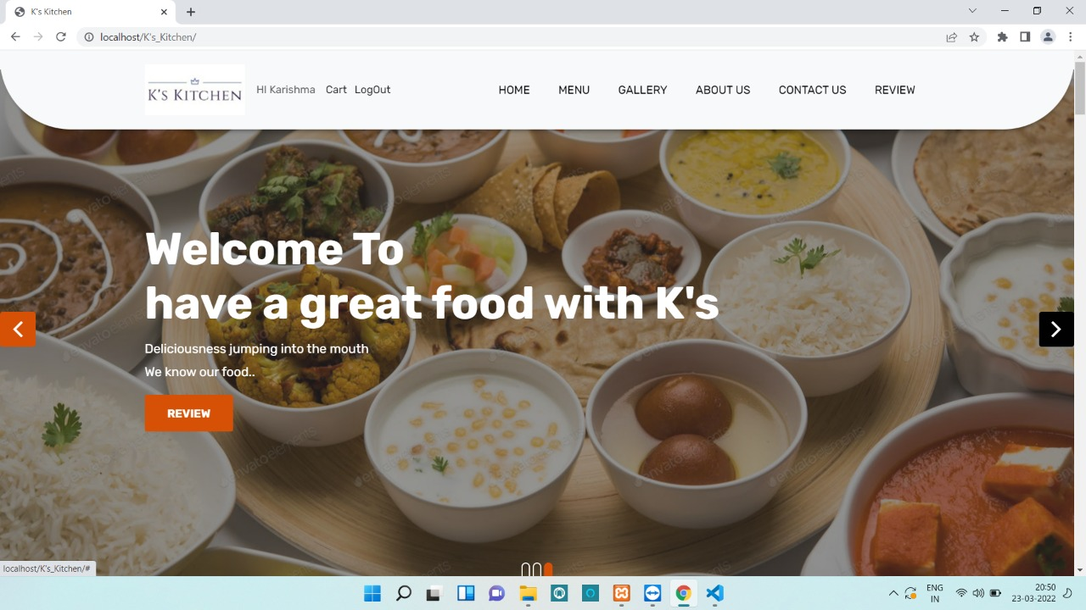
Output ss
Home Page
Home Page

Slide 11
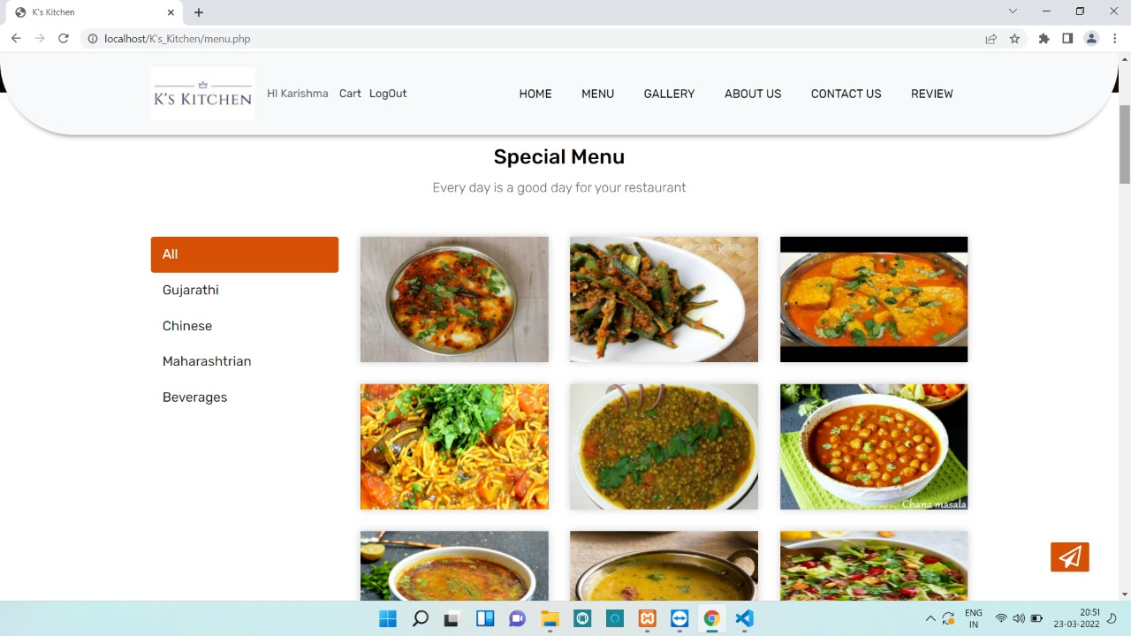
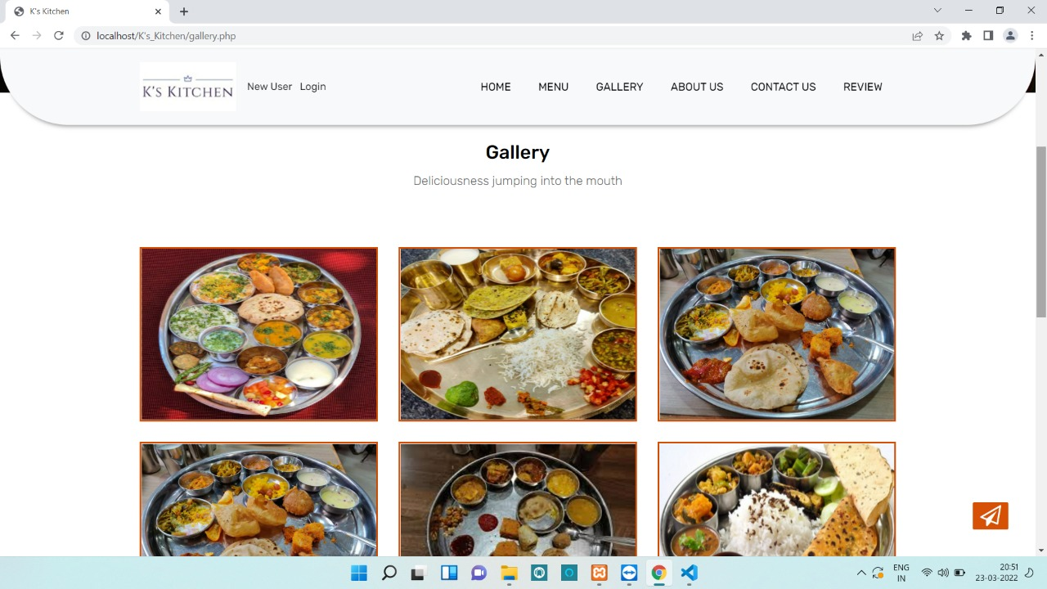
Food Menu
Gallery

Slide 12
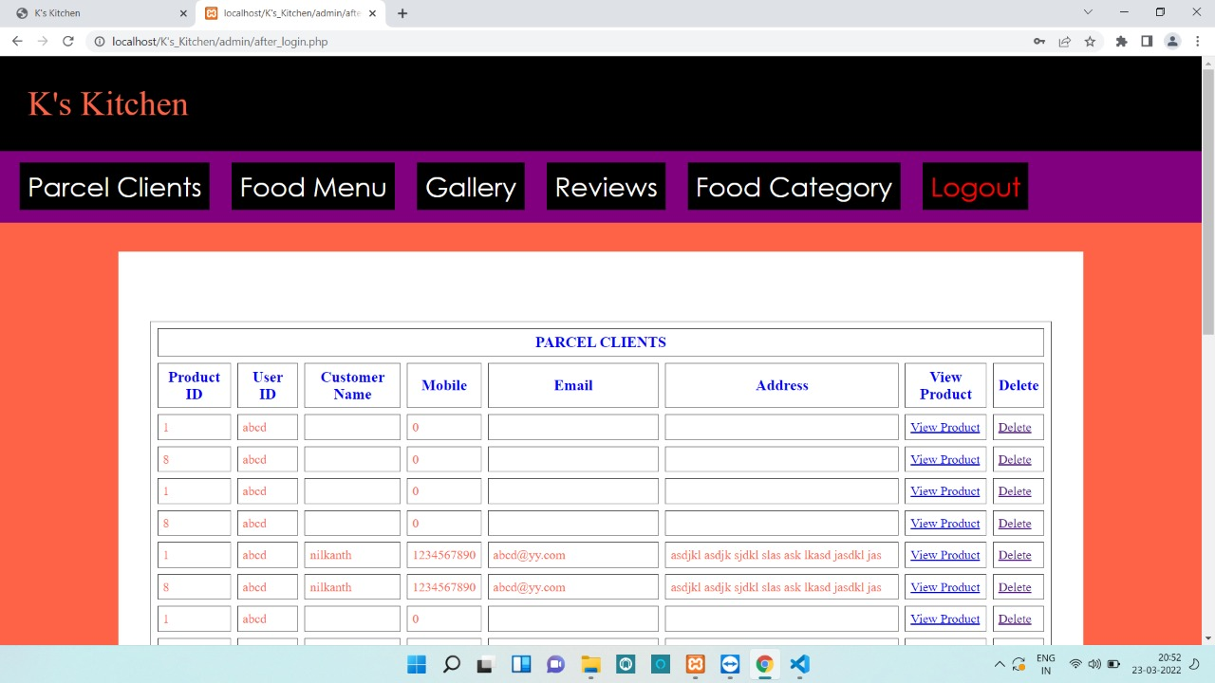
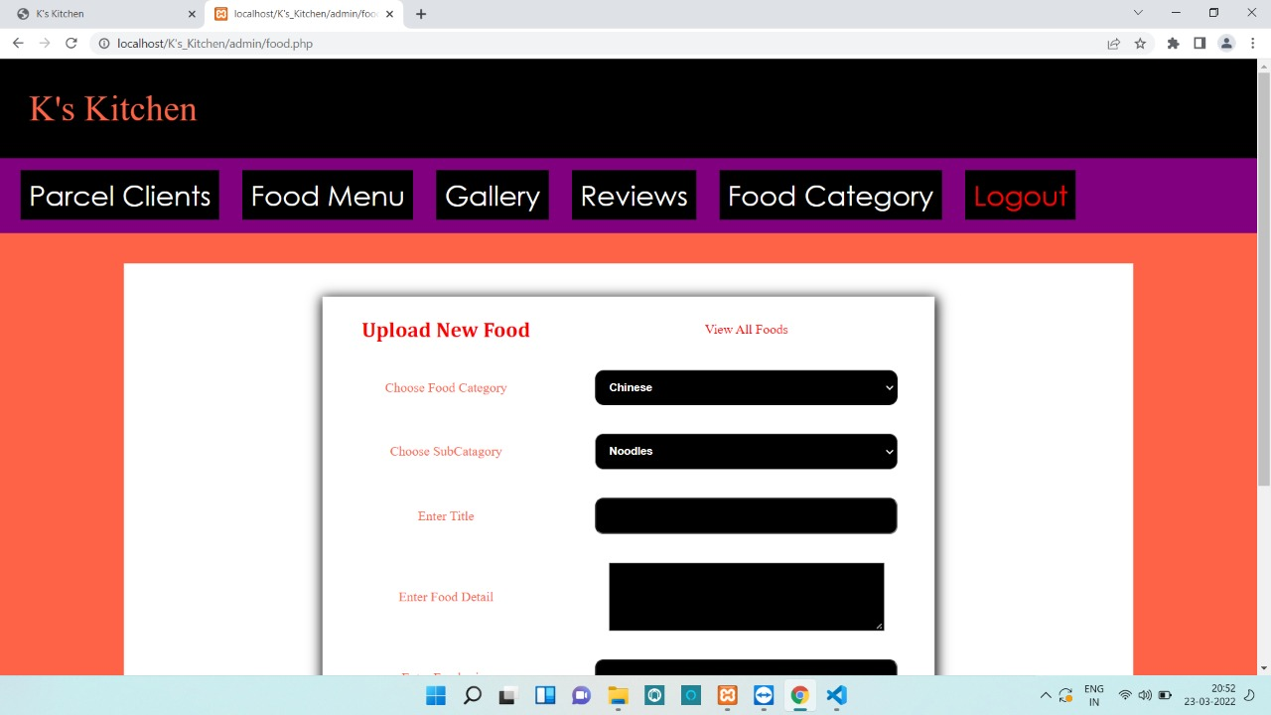
Client’s Parcel Details stored on Admin Side
Food Category section to add new food on Admin Side

Slide 13
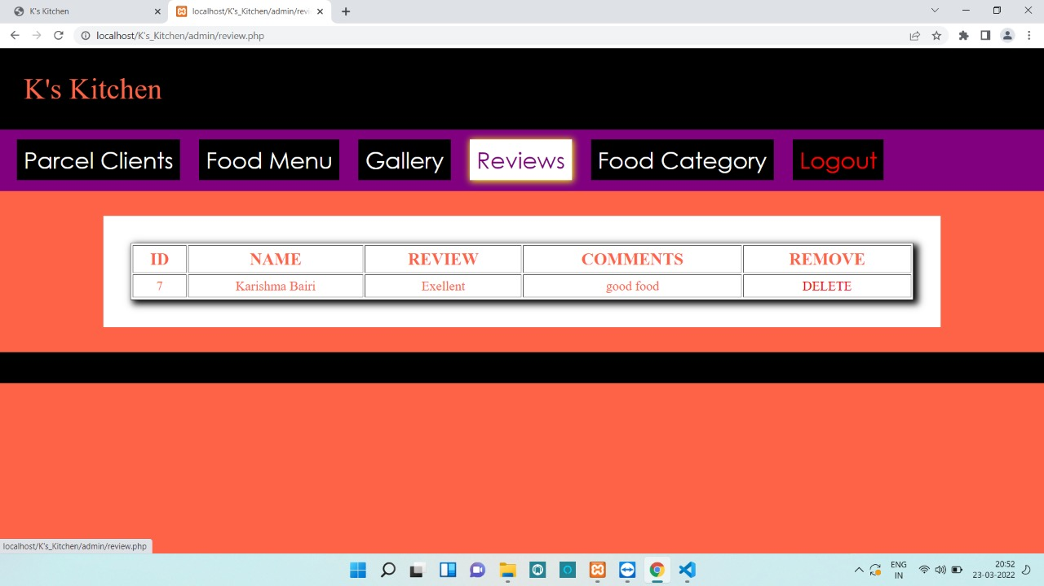
Review Section on Admin Side consists of feedback given by customers

Slide 14
conclusion
This website is developed where the customers can make an order for the food and avoid the hassles of waiting for the order to be taken by the waiter.
Using this website, the end users register online, read the E-menu card and select the food from the e-menu card to order food online. Once the customer selects the required food item the chef will be able to see the results on the screen and start processing the food.
This application nullifies the need of a waiter and reduces the workload of the waiter. The advantage is that in a crowded restaurant there will be chances that the waiters are overloaded with orders and they are unable to meet the requirements of the customer in a satisfactory manner. Therefore by using this website, the users can directly place the order for food online.

Slide 15
references
https://www.restaurant-website-builder.com/advantages-of-having-a-website-for-a-restaurant
https://www.researchgate.net/publication/259525214_A_review_of_literature_on_restaurant_menus_Specifying_the_managerial_issues
https://www.academia.edu/40212048/Restaurant_Management_System_Third_Year_Project_Report

